Slide 1
Module 2: Workflows and Data Handling
UiPath – Detailed Explanation with Diagrams

Slide 2
Sequence Workflow
Linear execution model
Activities execute step-by-step
Best for structured automation tasks
Linear execution model
Best for simple, step-by-step processes
Easy debugging
Used in structured automation tasks

Slide 3
Sequence Diagram
Step 1
Step 2
Step 3

Slide 4
Flowchart Workflow
Supports multiple branching logic
Suitable for complex decision making
Flexible execution paths
Supports complex decision making
Multiple branching paths
Good for business rule automation

Slide 5
Flowchart Diagram
Start
Decision
Path A
Path B

Slide 6
State Machine Workflow
Event-driven execution model
-- Based on states and transitions
Used in long-running workflows
Ideal for transactional processes

Slide 7
State Machine Diagram
State 1
State 2
State 3

Slide 8
Variables and Arguments
🔹 VARIABLES IN UiPath
In UiPath Studio, a Variable is a named memory location used to store data during workflow execution.

Slide 9
1️⃣ Formal DefinitionA variable is
1️⃣ Formal Definition
A variable is:
A typed container allocated in workflow scope to hold runtime values.
It has:
Identifier (Name)
Data Type
Scope
Default Value

Slide 10
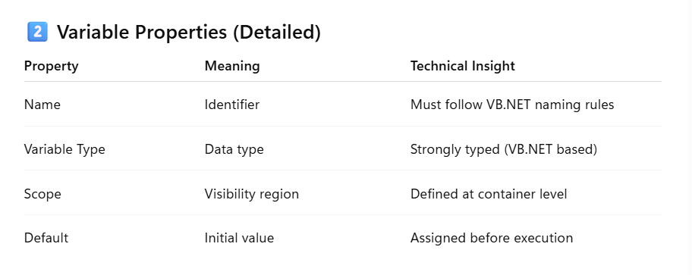

Slide 11
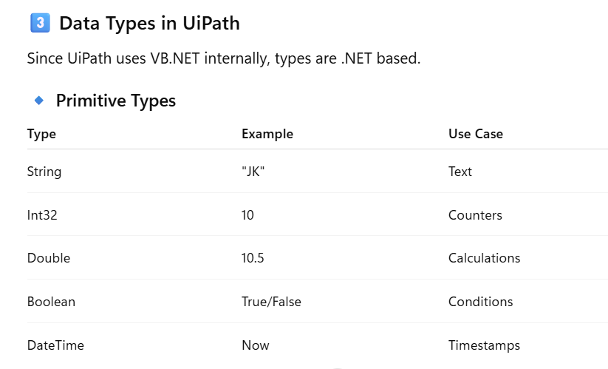

Slide 12
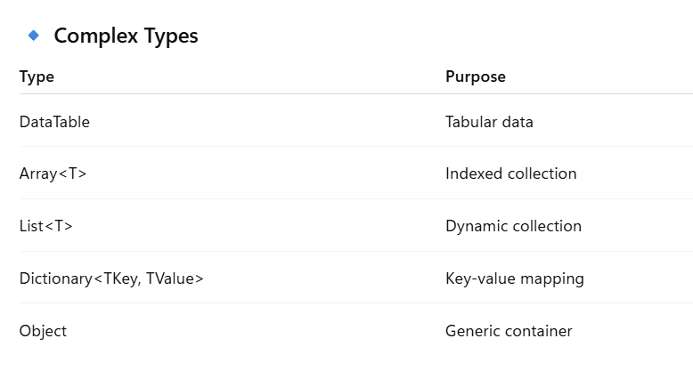

Slide 13
4️⃣ Scope of Variables
Scope determines lifetime + accessibility.
Example:
Sequence
├── Variable A (Scope: Sequence)
├── If
│ └── Variable B (Scope: If)
Variable A → Accessible everywhere inside Sequence
Variable B → Accessible only inside If
Important:
Scope is hierarchical (tree-based execution model).

Slide 14
🔹 ARGUMENTS IN UiPath
Arguments are used for:
Data communication between workflows.
Think of arguments like function parameters in programming.
1️⃣ Why Arguments?
If workflow A calls workflow B:
Variables cannot cross workflow boundary.
Arguments enable controlled data exchange.

Slide 15
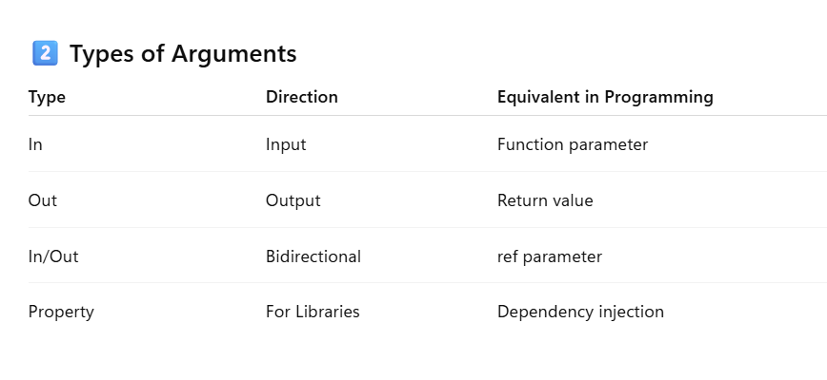

Slide 16
✅ Variable
A local memory container used to store data inside a workflow.
✅ Argument
A data transfer mechanism used to pass values between workflows.

Slide 17
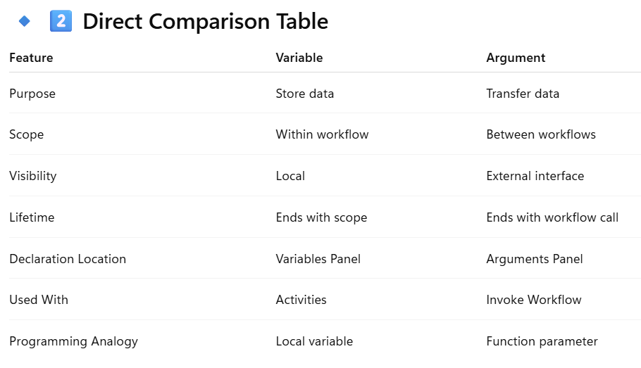

Slide 18
Input/Output data handling
In UiPath Studio, Input/Output data handling refers to how a workflow receives data (input), processes it, and returns or stores results (output). In RPA design, this is usually implemented using arguments, variables, files, and external data sources.

Slide 19
1. Input Data Handling in UiPathInput data is the information provided to a workflow before execution.
Source | Description | Example
Arguments | Data passed from parent workflow to child workflow | Customer ID
User Input | Data entered by user through dialogs | Username
Files | Excel, CSV, text files | Sales data
Databases | SQL queries | Customer records
Applications/Web | Extracted using selectors | Invoice number
APIs | REST services | JSON response

Slide 20
Example Activities
Input Dialog
Read Range (Excel)
Read Text File
HTTP Request
Get Text / Get Attribute

Slide 21
2. Output Data Handling in UiPath
Output data is the result generated after processing.
Destination | Example
Message Box | Display results
Excel File | Write processed data
Database | Insert record
Text File | Save logs
Arguments | Return value to parent workflow
Email | Send report

Slide 22
Example Activities
Write Range
Write Text File
Insert Query
Send Outlook Mail
Message Box

Slide 23
3. Arguments for Input/Output
Arguments are used to pass data between workflows.
Types of Arguments Type | Direction | Use
In | Input only | Receive data
Out | Output only | Send result
In/Out | Both directions | Modify existing data

Slide 24
4. Variables in Data Handling
Variables temporarily store data inside the workflow.
Common Types: Type | Use
String | Text
Int32 | Numbers
Boolean | True/False
DataTable | Excel data
Array | Multiple values

Slide 25
Control Flow and Loops
If, Switch for conditions
While, Do While loops
For Each Row for DataTables

Slide 26
Data Manipulation
Assign, Filter Data Table
Sort Data Table
LINQ Queries for advanced processing

Slide 27
Data-Driven Automation
Read Excel into DataTable
Loop through records
Process each record dynamically

Slide 28
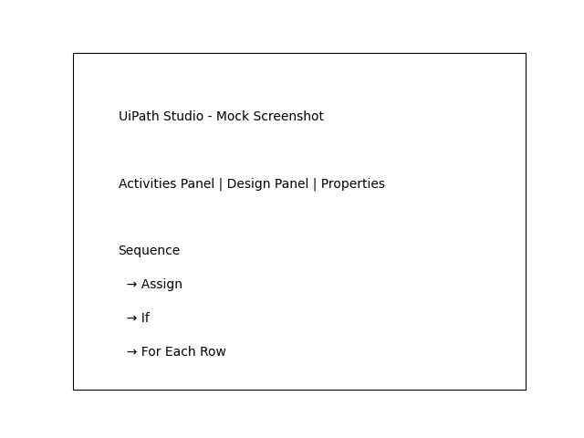
UiPath Studio Interface Overview

Slide 29
Sequence with Activities

